Slide 1
U.S. Regions Project

Slide 2
U.S. Regions Project
You will do this project at home.
We haven’t learned all the regions yet, but I will send all the lessons and materials.

Slide 3
U.S. Regions Project
You will choose one of the regions.
You will choose one topic.
You will choose one project format.

Slide 4
U.S. Regions
Southeast
Northeast
West
Midwest
Southwest

Slide 5
Topics
Agriculture (food)
Climate
Landforms
Landmarks

Slide 6
Examples
I’m going to show some examples of these projects.
Some of these examples do not show a project based on a REGION, but I wanted you to see what brochures, posters, and infographics look like.

Slide 7
Project Formats
Brochure
Poster
Infographic

Slide 8
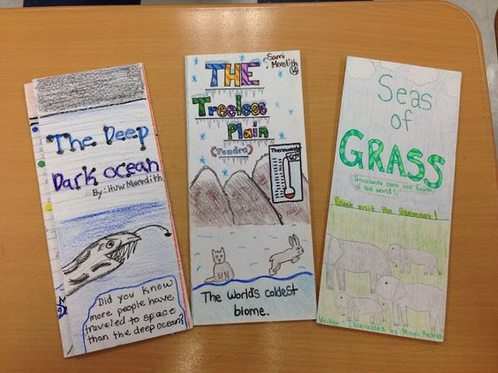
Brochure: A paper folded in thirds

Slide 9
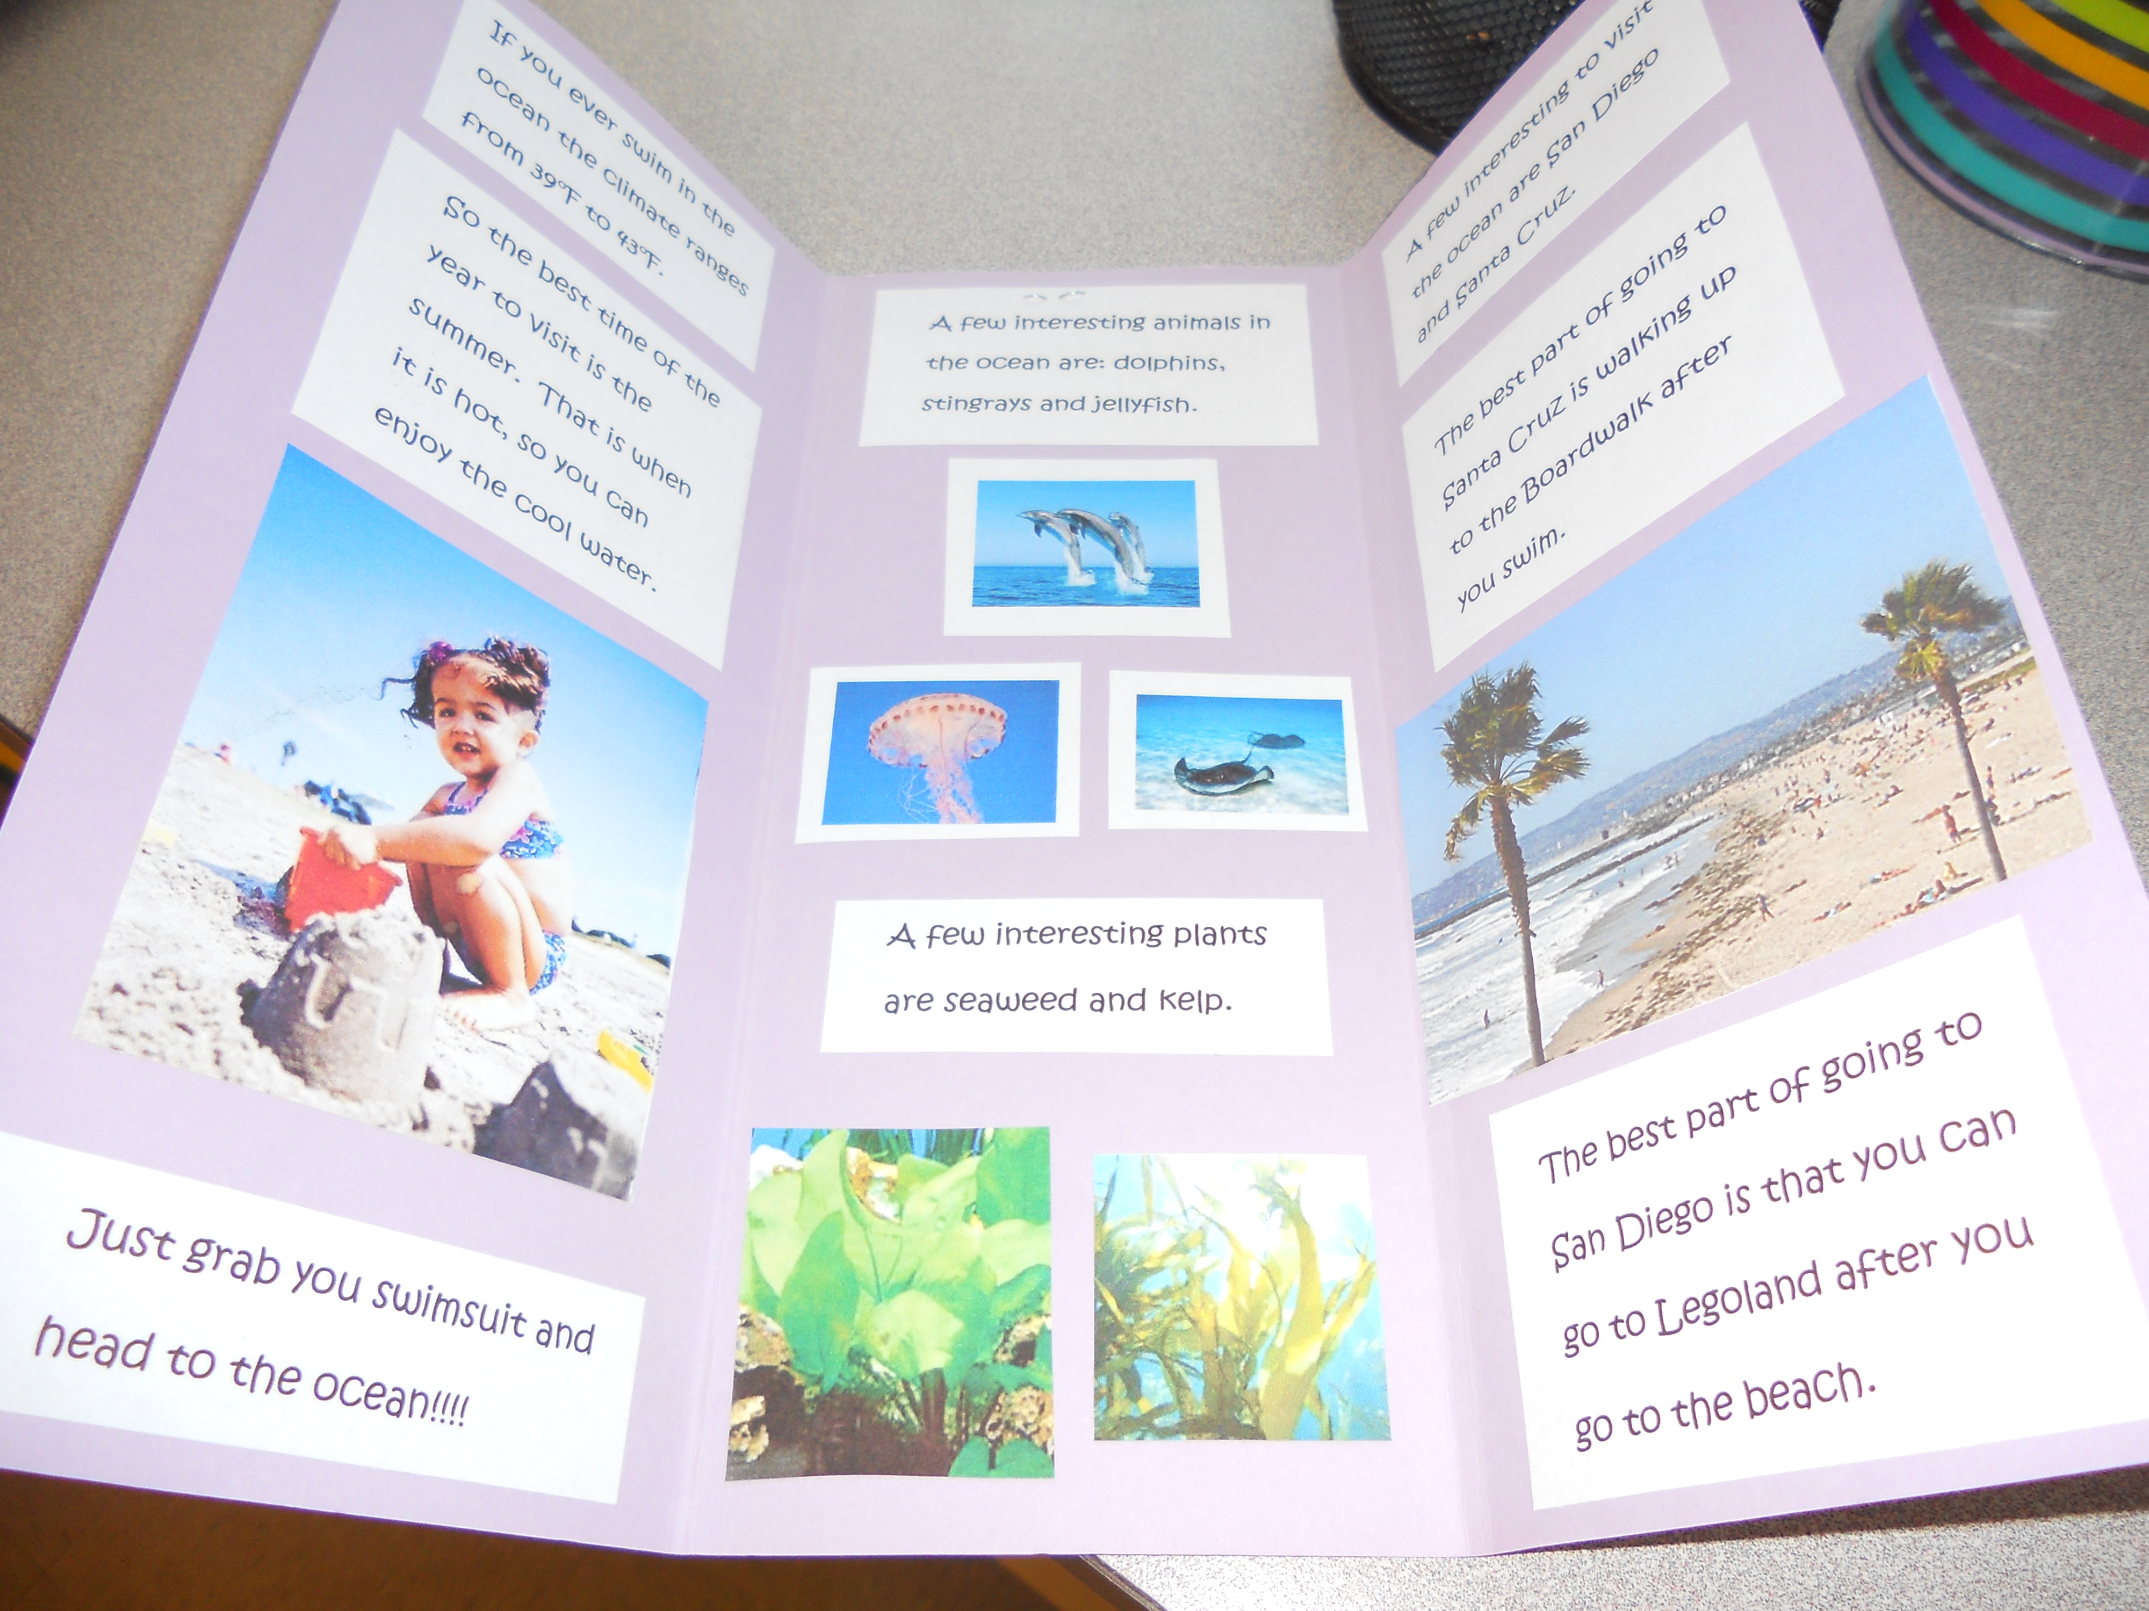

Slide 10
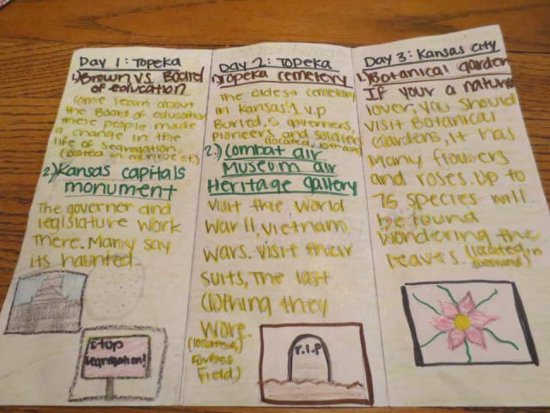

Slide 11
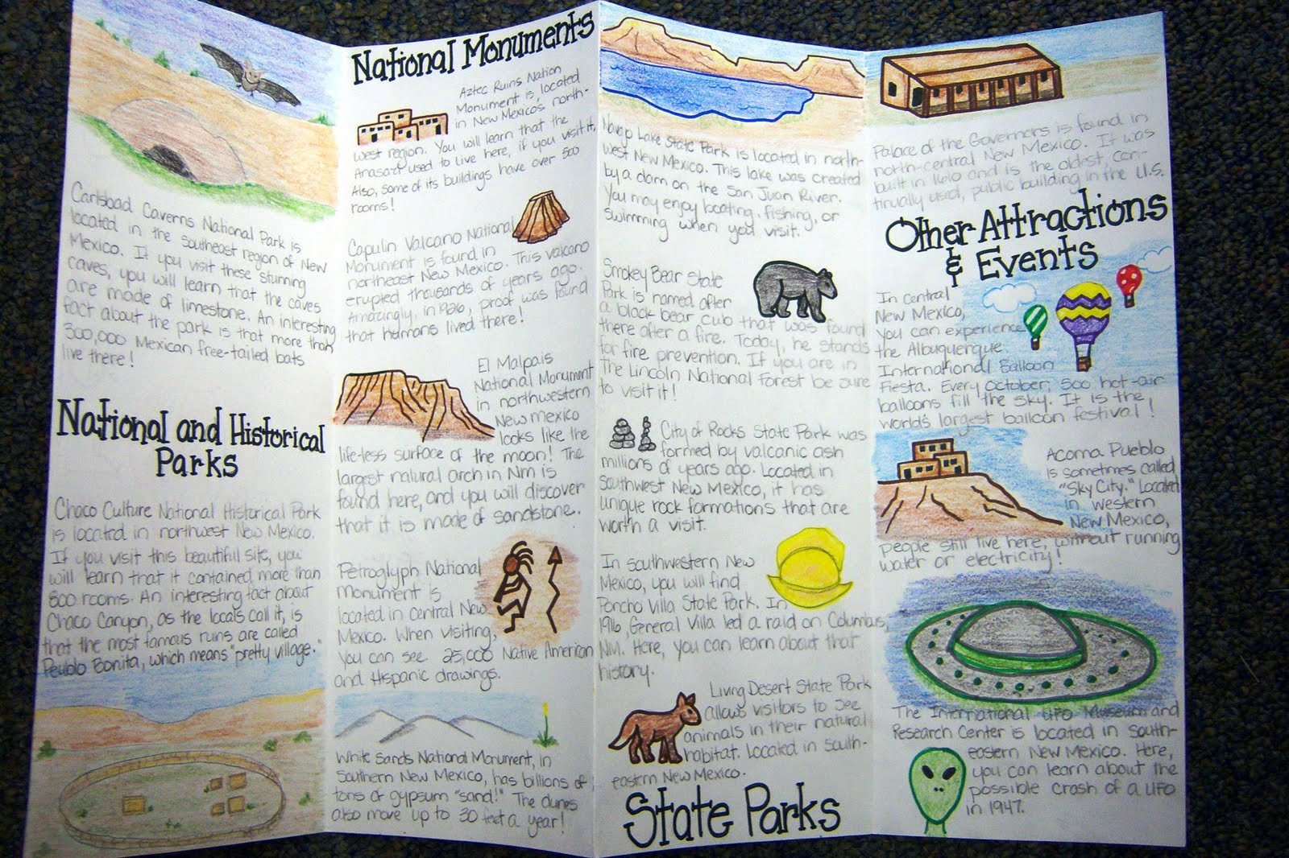

Slide 12
Poster
On a posterboard
Title, pictures, and captions

Slide 13
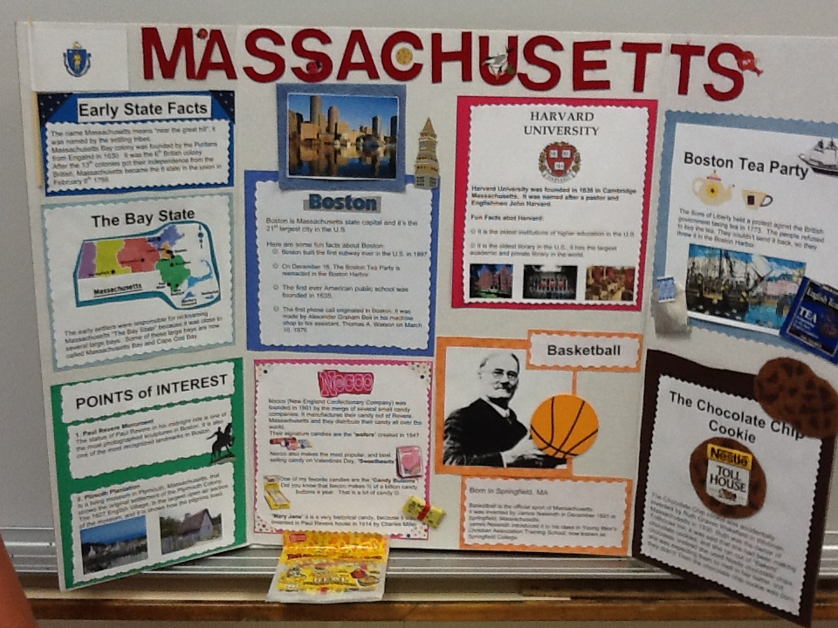

Slide 14
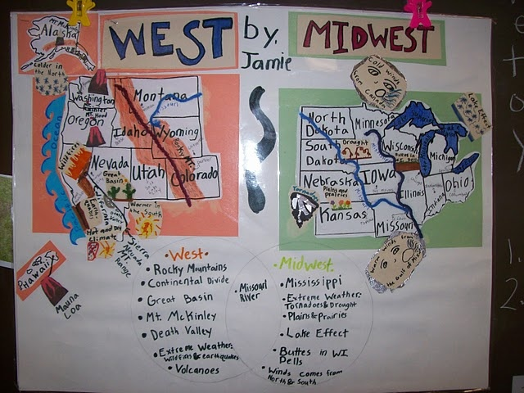

Slide 15
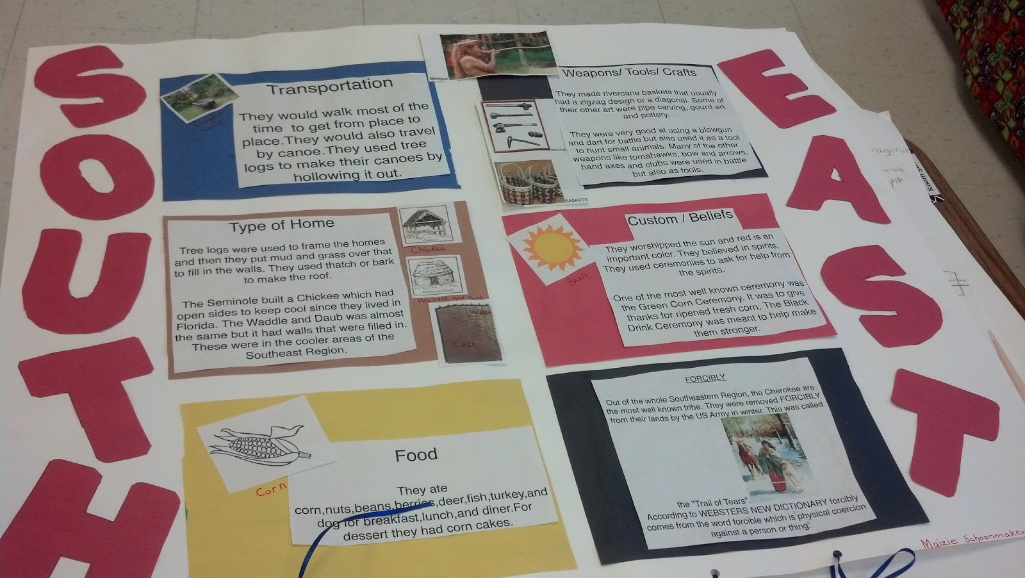

Slide 16
Infographic
Uses symbols and graphs to show information

Slide 17
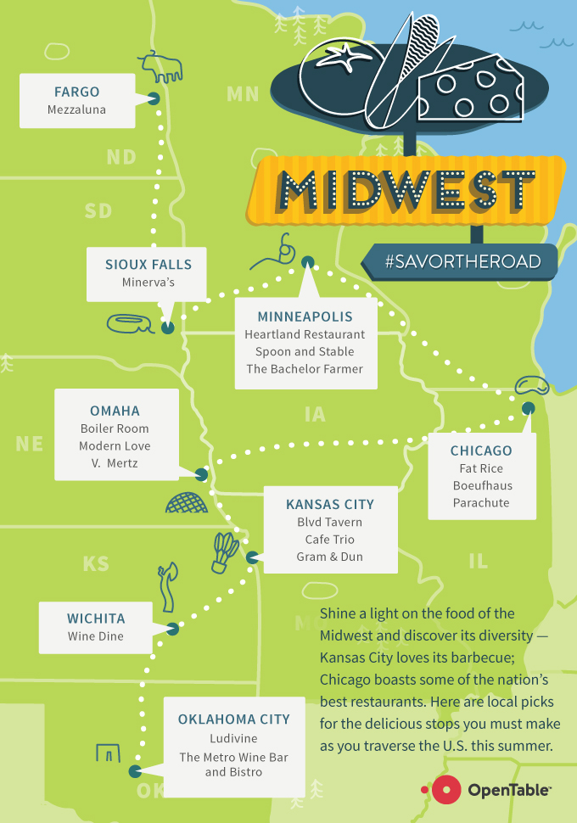
https://pages.mapsofworld.com/wp-content/uploads/2011/08/california-fast-facts-infographic.jpg
https://i.pinimg.com/736x/7b/2b/76/7b2b7699f3de534850f903061168ca95--texas-rising-texas-vacations.jpg

